Slide 1

Made by
Yuganter Sharma

Slide 2
Introduction
As computer technology continues to develop, people have smaller and smaller electronic devices.
Increasingly we are recognizing the importance of human computing interaction (HCI), and in particular vision-based gesture and object recognition.
In our project, we propose a novel approach that uses a video device to control the mouse system(Mouse tasks).
We employ several image processing algorithms to implement this.

Slide 3
Project Scope
For most laptop touchpad is not the most comfortable and convenient.
Virtual mouse, known as Virtual Multitask Mouse.
This is real time application.
User friendly application.
This project removes the requirement of having a physical.

Slide 4
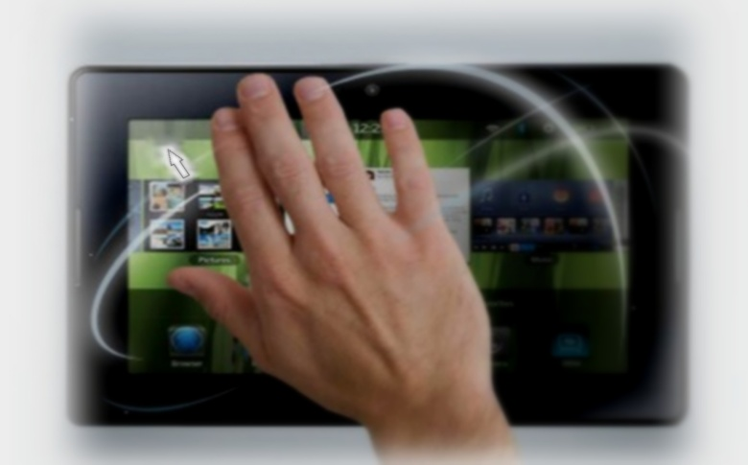
Goal and Objective
The goal is to manage computers and other devices with gestures rather than pointing and clicking a mouse or touching a display directly.
Backers believe that the approach can make it not only easier to carry out many existing chores but also take on trickier tasks such as creating 3-D models, browsing medical imagery during surgery without touching anything.
Reduce cost of hardware.

Slide 5
Problem Statement
To design virtual mouse which detects hand gestures patterns instead of physical mouse.
Basically we use colored tips for detection which are captured by webcam.
Here, the colored fingertip acts as an object which the web cam senses.
The camera is positioned such that it recognizes the moment of finger tips and performs the operations of mouse.
The utilization of virtual mouse appears in space saving situations or in movement situation.

Slide 6
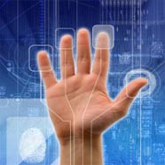
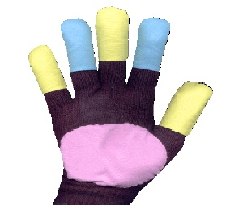
Literature Survey
HCI Technology
  Human-computer interaction (HCI) is an area of research and practice that emerged in the early 1980s.
Gesture Recognition
  Gesture recognition is the mathematical interpretation of a human motion by a computing device.
Using Palm Using Glove

Slide 7
Color Calibration
Color Calibration is one of the segments that we addressed for a biological discipline. Apart from object detection and segmentation, it requires color correction for a color-based analysis.
The major problem in color analysis is that it is hard to control the lighting condition while taking the photo. The same color will be measured as a different color for photos taken under different lighting conditions

Slide 8
Colors Representation
Images are digitally represented in n-dimensional space holding the color details. In Computer Vision, the images are read as 2 dimensional bit array holding the value of pixel value. Each pixel value can be represented in a different color model called color space like RGB, LAB, HSV.

Slide 9
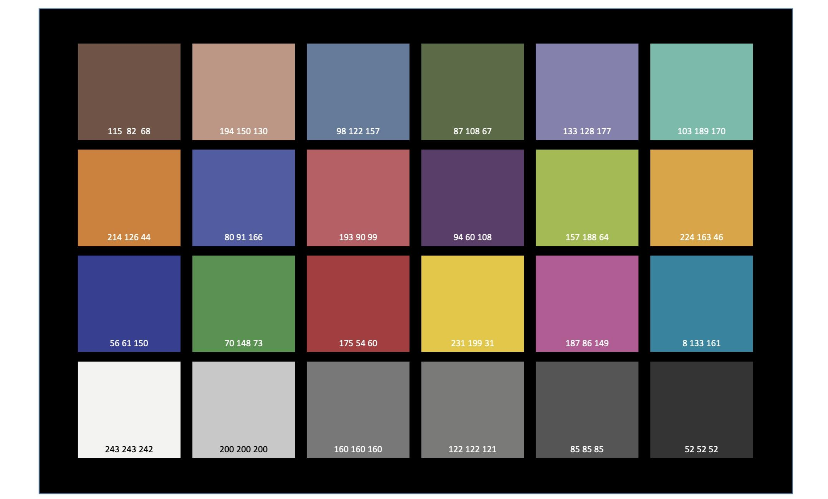

Slide 10
We know the colors of these 24 squares from the Macbeth Color Checker chart. We use these colours for calibration.
Now the user gets to calibrate the colour ranges for three of his fingers individually. This is done by calling the calibrate Color() function thrice right at the beginning of the program. The user has an option to use the default settings as well.

Slide 11
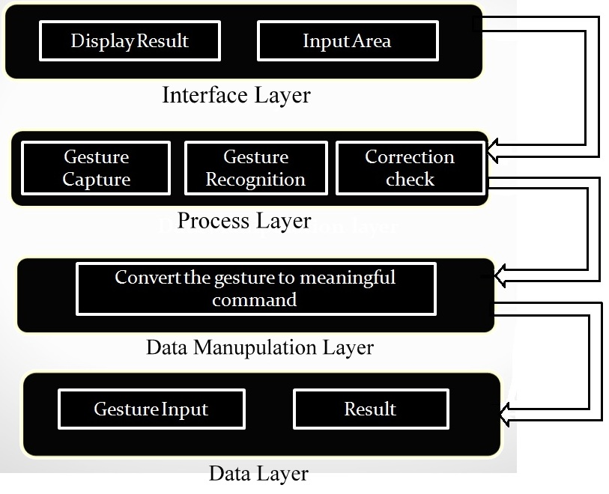
Architecture
There are following layer:
Interface Layer
Process Layer
Data Manupulation Layer
Data Layer

Slide 12
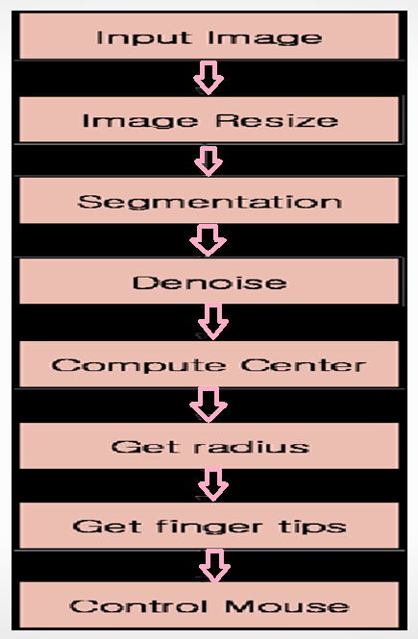
Design

Slide 13
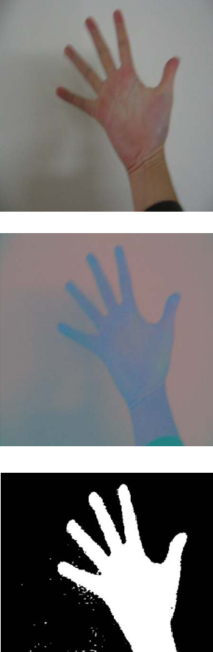
1.Image Resize
Map camera coordinates to screen coordinates.
2.Segmentation
Separate the hand area from a complex background.
we converted from RGB color space to YCbCr color space, and then to binary image.

Slide 14
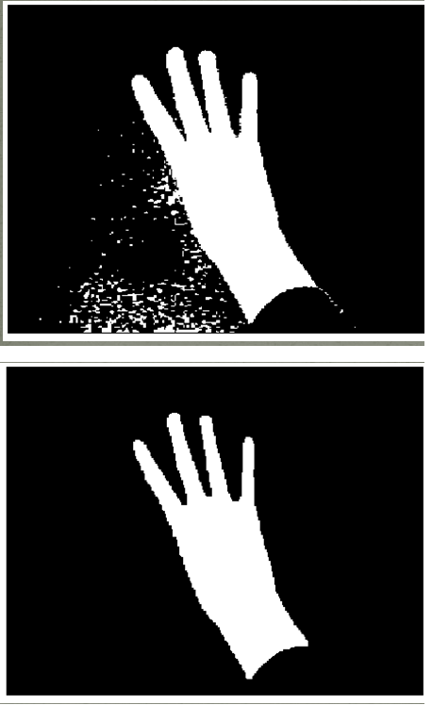
3.Denoise
Need to delete noisy pixels from the image.
We use an image morphology algorithm that performs image erosion and image dilation to eliminate noise .
Erosion trims down the image area where the hand is not present .
Dilation expands the area of the Image pixels which are not eroded.

Slide 15
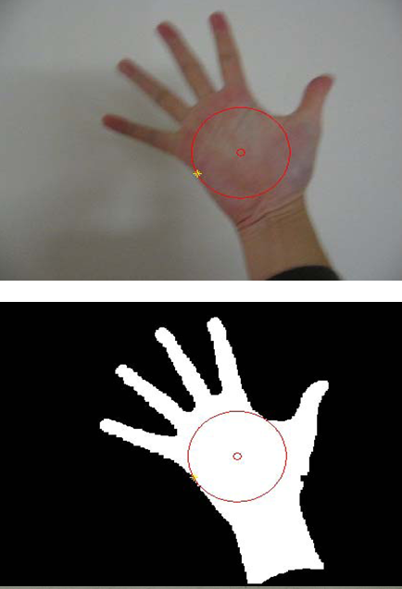
4.Finding center and the size of the hand
Locate the center of the hand, we compute the radius of the palm region to get hand size.
Draw a circle increasing the radius of the circle from the center coordinate until the circle meets the first black pixel.
When the algorithm finds the first black pixel then it returns to the current radius value.

Slide 16
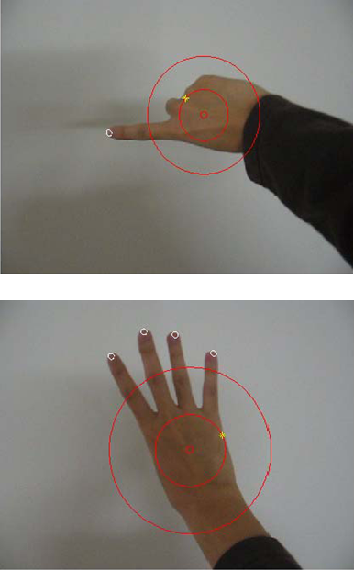
  5.Finding finger tip
The convex hull algorithm is used to solve the problem of finding the biggest polygon including all vertices.
we can detect finger tips on the hand. We used this algorithm to recognize if a finger is folded or not.
Check the distance between the center and a pixel which is in convex hull set.

Slide 17
6.Controlling Mouse
Weighted speed cursor control. We get a difference of the finger of the current image and the previous image and compute the distance between the two.
Next, we move the mouse cursor if the gap between the two finger images (current and previous frame) is far then the mouse cursor moves fast or, if the gap is close then the cursor moves slow.
Left clicking.
Right clicking.
Double clicking.
Scrolling.

Slide 18
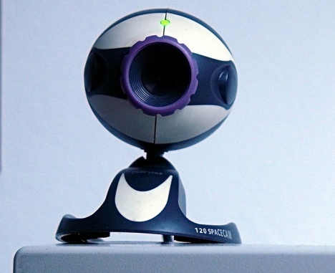
Hardware & Software Requirement
Web Cam
C# is one of the programming languages designed for the Common Language Infrastructure. It was developed by Microsoft .
OpenCV (Open Source Computer Vision Library) is a library of programming functions mainly aimed at real-time computer vision, developed by Intel.
OpenCV runs on Windows, Android, iOS, Linux and Mac OS.

Slide 19
Advantages
The main advantage of using hand gestures is to interact with computer as a non-contact human computer input modality.
Reduce hardware cost by eliminating use of mouse.
Convenient for users not comfortable with touchpad.
The framework may be useful for controlling different types of games and other applications dependent on the controlled through user defined gestures.

Slide 20
Limitations
The present application though seems to be feasible and more user friendly.
An attempt to make the input modes less constraints dependent for the users hand gestures has been preferred.
Another important aspect for the related development could be design of an independent gesture vocabulary framework.
The colour detection algorithm can cause detection problem if another coloured rubber in working domain of webcam.

Slide 21
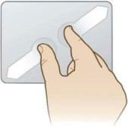
Future Scope
In the future, we plan to add more features such as enlarging and shrinking windows, closing window, etc. by using the palm and multiple fingers.
We can also open the browser or any drives (C: /D:/E: etc)with the help of hand gesutures instead of moving the cursor.

Slide 22
Conclusion
We are developing a system to control the mouse cursor using a real-time camera.
This system is based on computer vision algorithms and can do all mouse tasks.
However, it is difficult to get stable results because of the variety of lighting and skin colors of human races.
This system could be useful in presentations and to reduce work space.
Features such as enlarging and shrinking windows, closing window, etc. by using the palm and multiple fingers.

Slide 23


